Slide 1




MIcro- and NAno-Plastics in AGRIcultural Soils:
Sources, environmental fate and impacts on ecosystem services and overall sustainability
Violette Geissen
Wageningen University

Slide 2

Where do plastic debris in agriculture come from ?

Slide 3
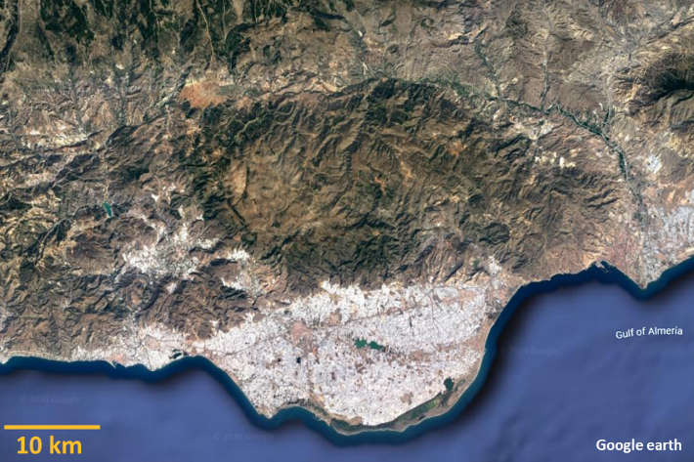
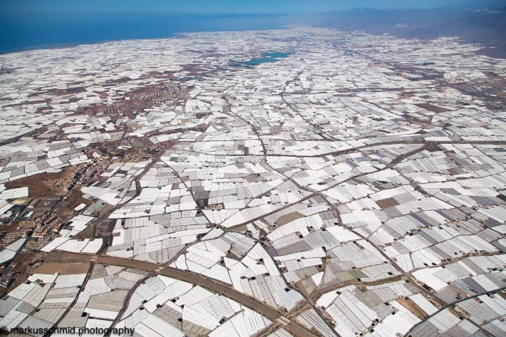
Greenhouses
“the sea of plastic”
Almeria (South Spain)

Slide 4
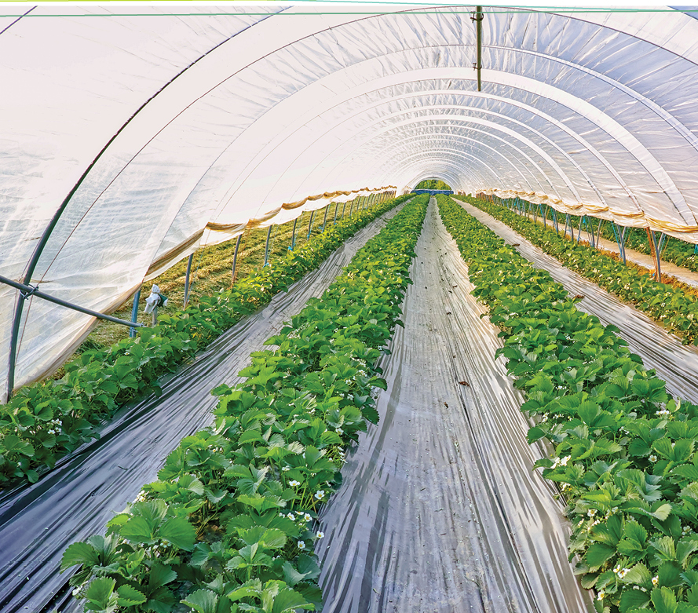
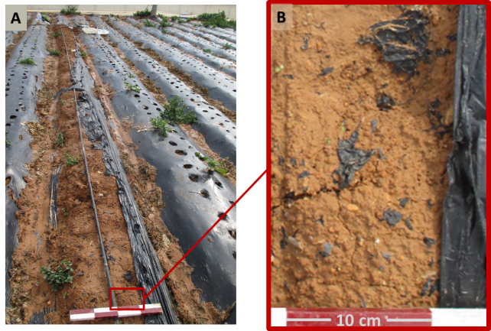
Greenhouses
“the see of plastic”
Almeria (South Spain)
Plastic mulch

Slide 5
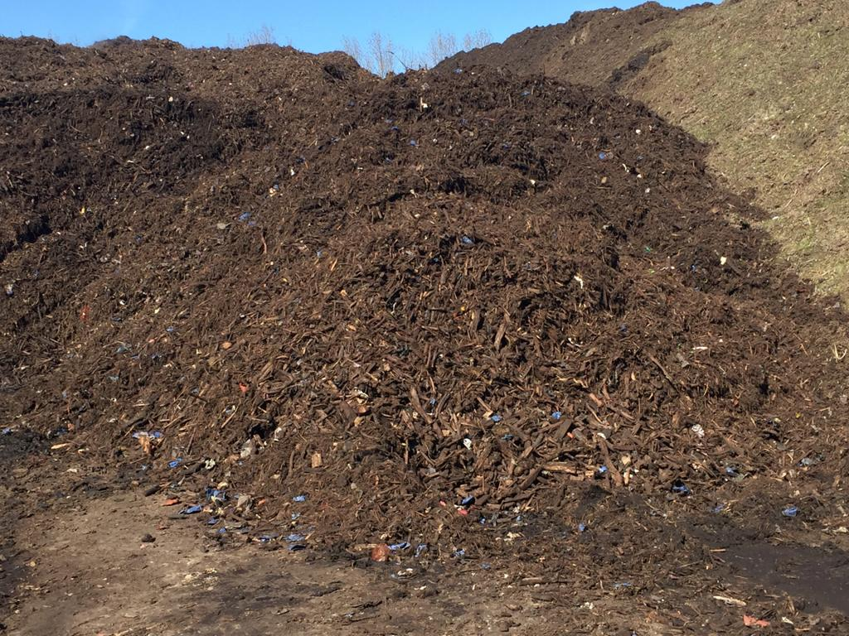
Compost
Organic fertilizers
Sewage sludge
Greenhouses
“the see of plastic”
Almeria (South Spain)
Plastic mulch

Slide 6
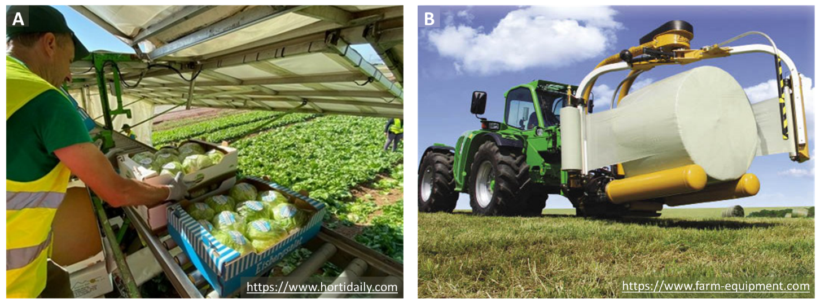
Compost
Organic fertilizers
Sewage sludge
Greenhouses
“the see of plastic”
Almeria (South Spain)
Plastic mulch
Other plastic uses
Notes:
Corradini et al 2019 https://doi.org/10.1016/j.scitotenv.2019.03.368

Slide 7
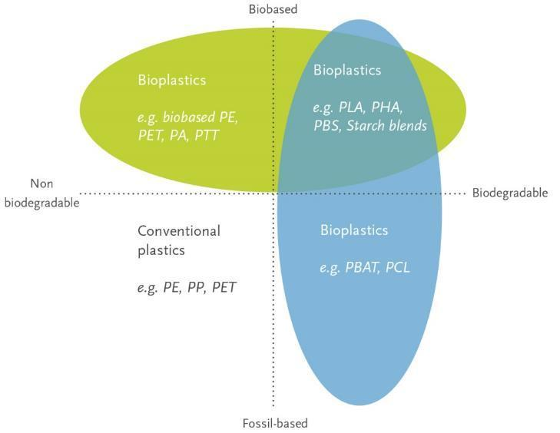
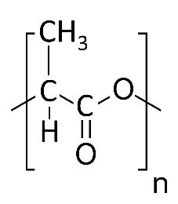
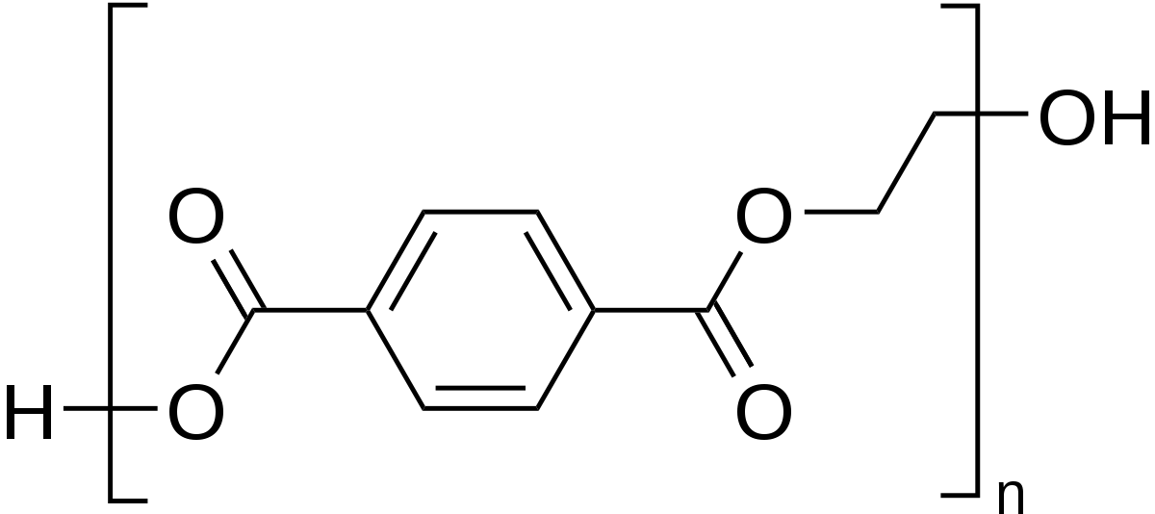
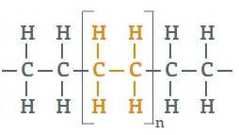
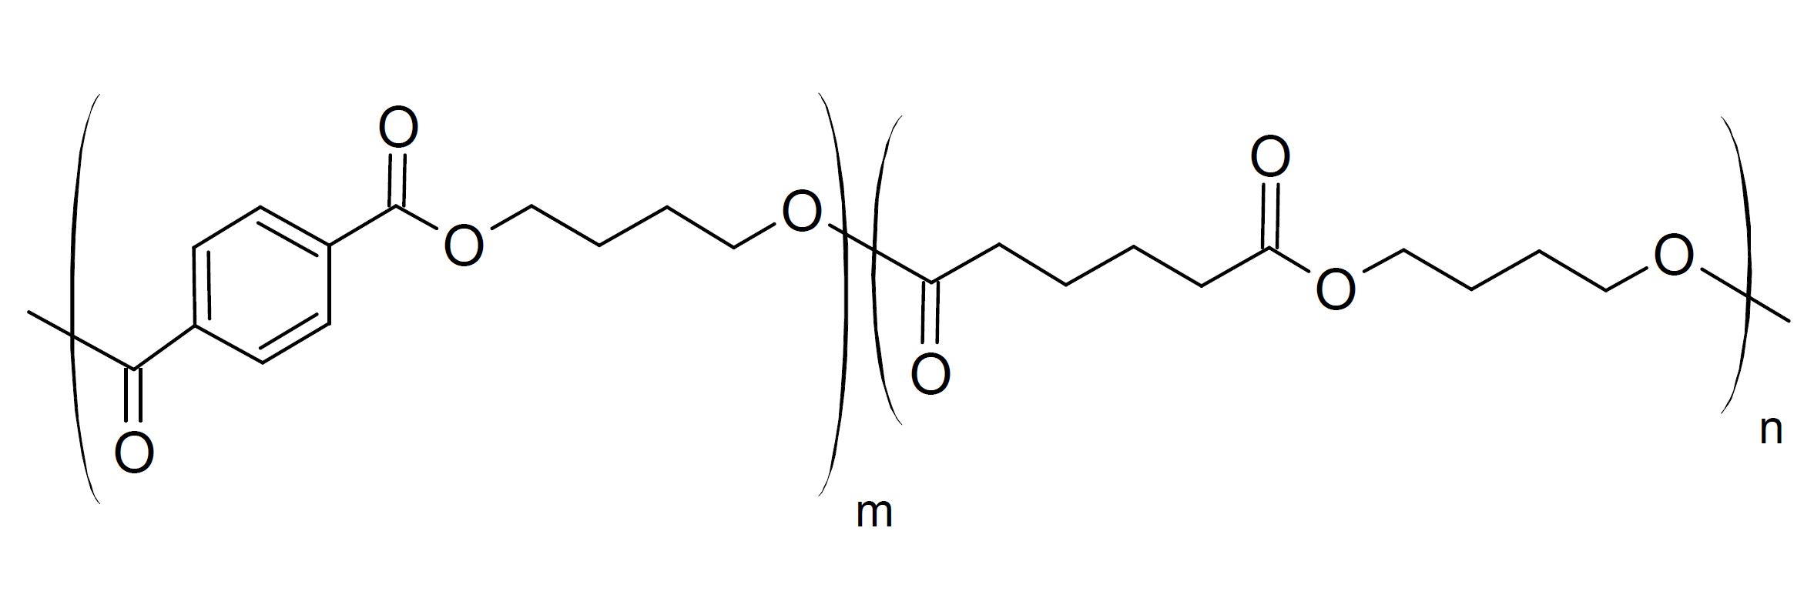
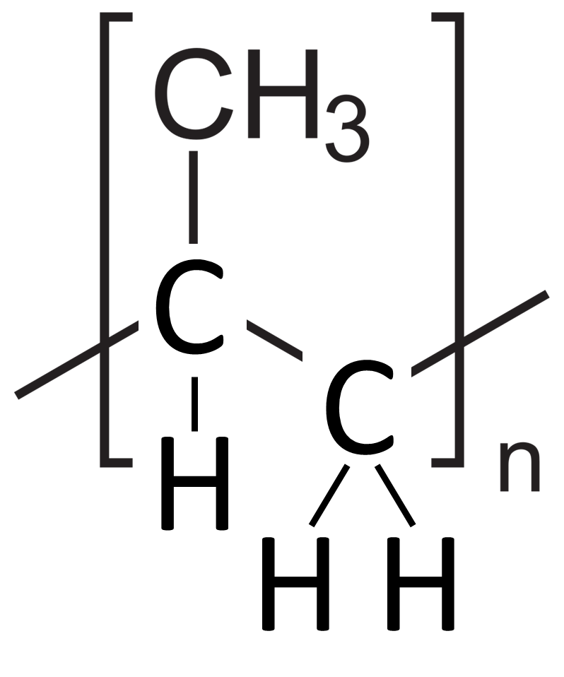
What are plastic made of ?
Polylactic acid (PLA)
A diversity of plastic polymers
Polyethylene terephthalate (PET)
Biodegradation is not only an intrinsic property of the plastic! It also depends on:
Temperature
Humidity
Solar radiation
Soil microbiome activity
Polyethylene (PE)
Polypropylene (PP)
Polybutylene adipate terephthalate (PBAT)

Slide 8
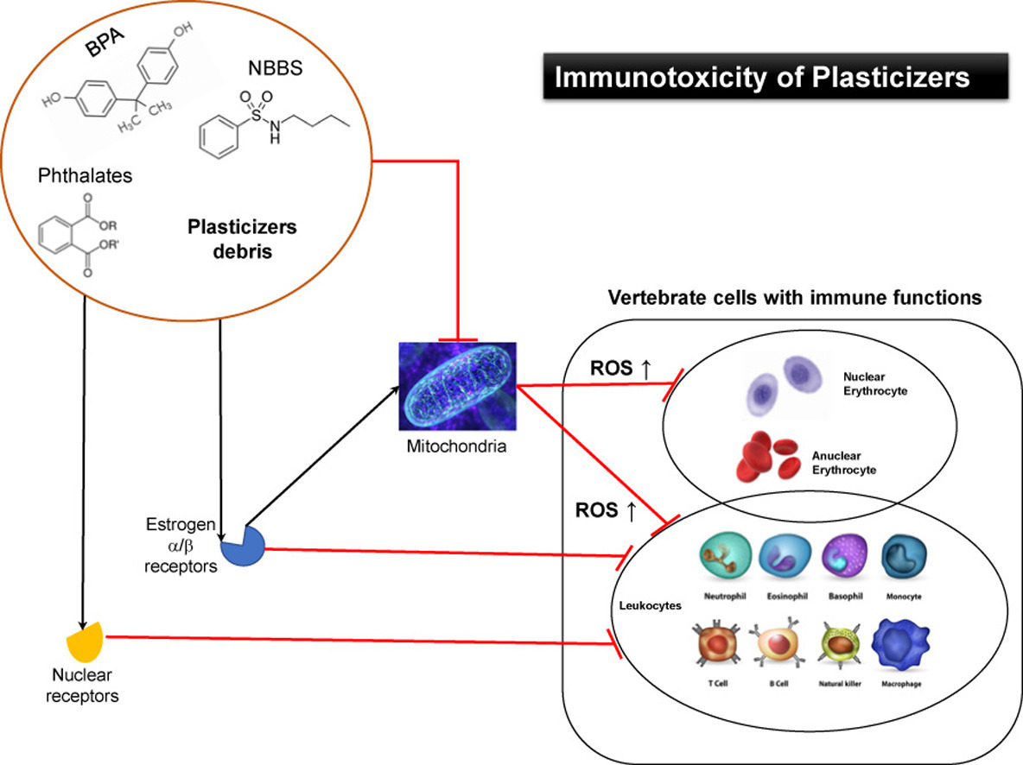
What are plastic made of ?
A diversity of plastic
additives
Burgos-Aceves et al 2021
https://doi.org/10.1016/j.jhazmat.2020.124114

Slide 9
The objectives of the MINAGRIS project

Slide 10
1. Assess plastic accumulation and degradation in soil

Slide 11
1. Assess plastic accumulation and degradation in soil
2. Assess plastic debris transport

Slide 12
1. Assess plastic accumulation and degradation in soil
2. Assess plastic debris transport
3. Assess effects on eco system services

Slide 13
4. Assess effects on crop production and on farm economics
1. Assess plastic accumulation and degradation in soil
3. Assess effects on eco system services
2. Assess plastic debris transport

Slide 14
11 Case Study Sites covering the 6 main biogeographical regions in Europe

Slide 15
Multi-actor and inclusive research, with and for the farmers: Multi-Actor Platform setup

Slide 16
Nine work packages linked to fulfil the objectives
WP1
Project management

Slide 18
Communication and Dissemination to maximise impact

Slide 19

















With all our partners

Slide 20
Thank you for your attention

Slide 21
IPR management principles

Slide 22
MINAGRIS data flow

Slide 23
MINAGRIS Work Plan

Slide 24
Pert chart

